Slide 1

CAPSTONE PROJECT - 2
HOTEL BOOKING ANALYSIS
BY SAMPURNA TRIPATHY

Slide 2

INTRODUCTION
In the past few years, both the City Hotel and Resort Hotel have experienced significant increases in their cancellation rates. As a result, both hotels are currently facing a range of challenges, such as reduced revenue and underutilized hotel rooms. Therefore, the top priority for both hotels is to reduce their cancellation rates, which will enhance their efficiency in generating revenue.
This dataset contains 119390 observations for a City Hotel and a Resort Hotel. Each observation represents a hotel booking between the 1st of July 2015 and 31st of August 2017, including booking that effectively arrived and booking that were cancelled.
Each observation represents a hotel booking.
Bookings recorded from July 1, 2015 to August 31, 2017, including successful and cancelled bookings.
All data elements related to hotel and customer identification have been removed to ensure data privacy.

Slide 3

Analysis of High Cancellation Rates in Hotel Bookings
OBJECTIVE
The objective of this project is to help hotels increase revenue and improve operations by reducing cancellation rates, increasing customer retention, diversifying booking channels, optimizing pricing strategies, and enhancing operational efficiency.
PROBLEM STATEMENT
Both City & Resort Hotels are experiencing high cancellation rates, leading to reduced revenues and underutilized rooms.
POSSIBLE SOLUTIONS
Providing actionable solutions and strategies to minimize cancellations and improve bookings and revenue generation.
INSIGHTS
Sharing Key insights gained from the analysis, revealing patterns and correlation impacting cancellation rates.

Slide 4
HOTEL BOOKING DATASET
(119390)
CITY HOTEL
79330
RESORT HOTEL
40060
CANCELLED
(45%)
NOT CANCELLED
(55%)
CANCELLED
(25%)
NOT CANCELLED
(75%)
City hotels have almost double the reservation compared to Resort hotels. This might be due to the fact that Resorts might be more expensive than city hotels.
On the contrary City hotels have a higher cancellation rate than Resort hotels. This suggests that customer booking City hotels are more likely to cancel their reservation.

Slide 5
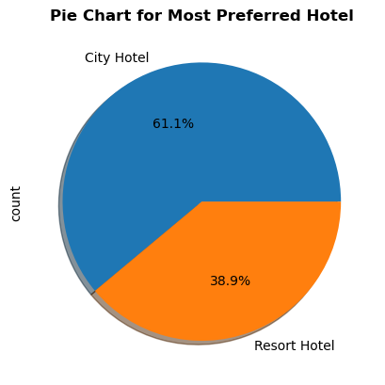
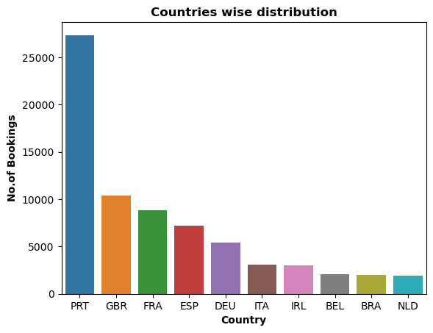
From the chart, we got to know that City Hotel is most preferred hotel by the guests. Thus City Hotel has maximum bookings. 61.1% guests are preferred City Hotel, while only 38.9% guests have shown interest in Resort Hotel.
​
People from all over the world are staying in these two hotels 50 % of the guests are from Portugal , Great Britain and France.

Slide 6
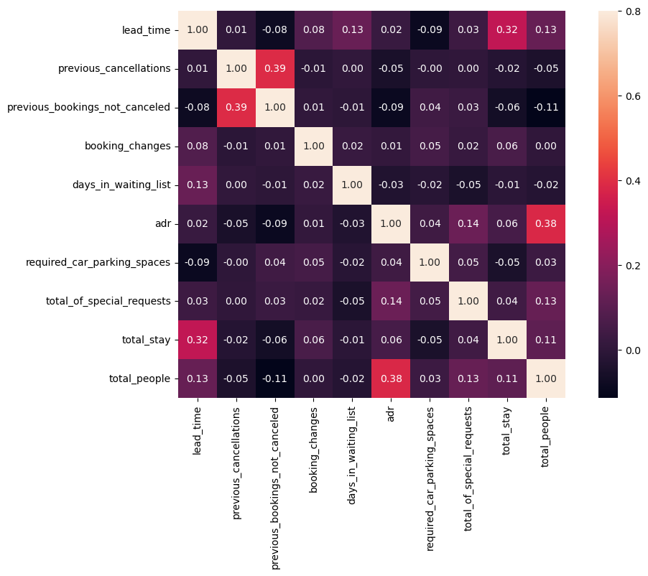
Total stay length and lead time have slight correlation. This may means that for longer hotel stays people generally plan little before the actual arrival.
adr is slightly correlated with total people, which makes sense as more no. of people means more revenue, therefore more adr.

Slide 7
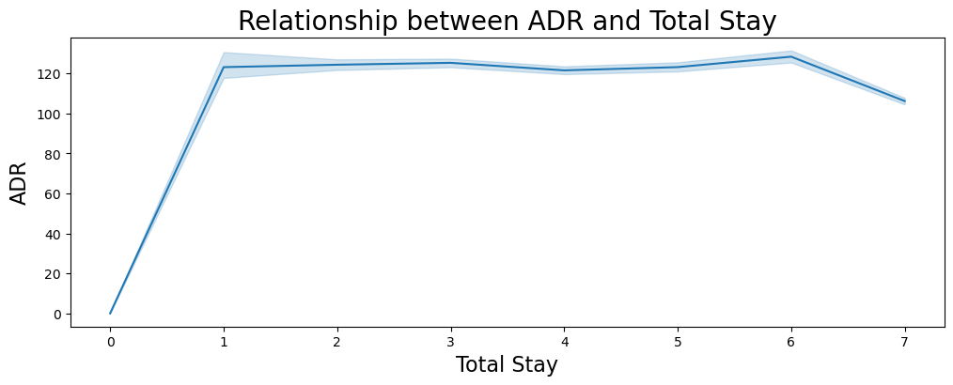
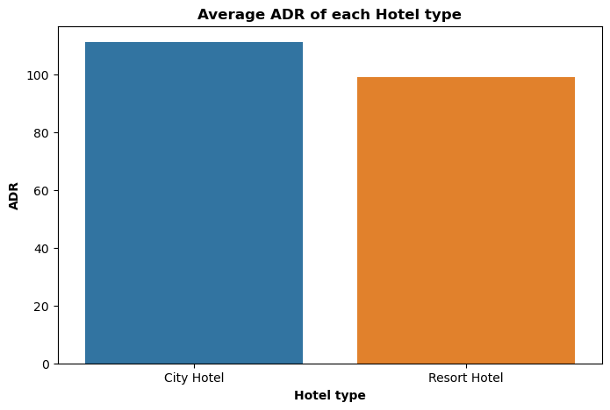
From this line chart, we have found that as the total stay increases the ADR is also getting high. So, ADR is directly proportional to total stay.
City Hotels are generating more revenues than the Resort Hotels, because City hotel has the highest ADR. More the ADR, more will be the revenue.

Slide 8
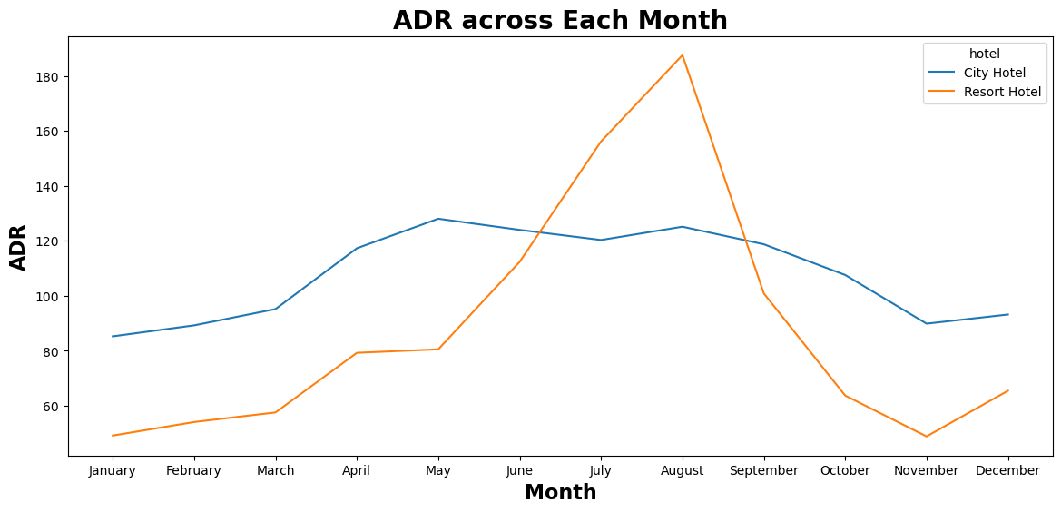
For Resort Hotel, ADR is high in the months of June, July, August as compared to City Hotels. The reason may be that customers/people want to spent their summer vacation in Resort Hotels.

Slide 9
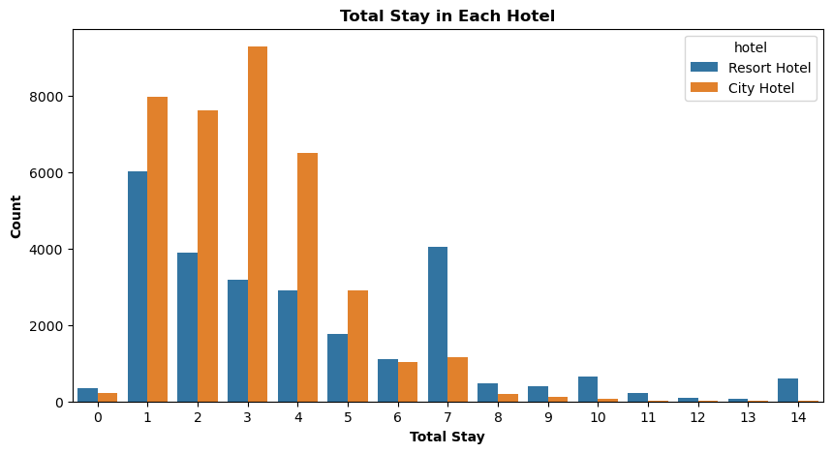
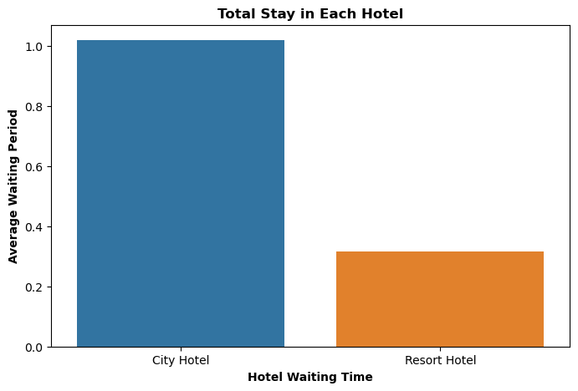
Most common stay length is less than 4 days and generally people prefer City hotel for short stay, but for long stays, Resort Hotel is preferred.
City hotel has significantly longer waiting time, hence City Hotel is much busier than Resort Hotel.

Slide 10
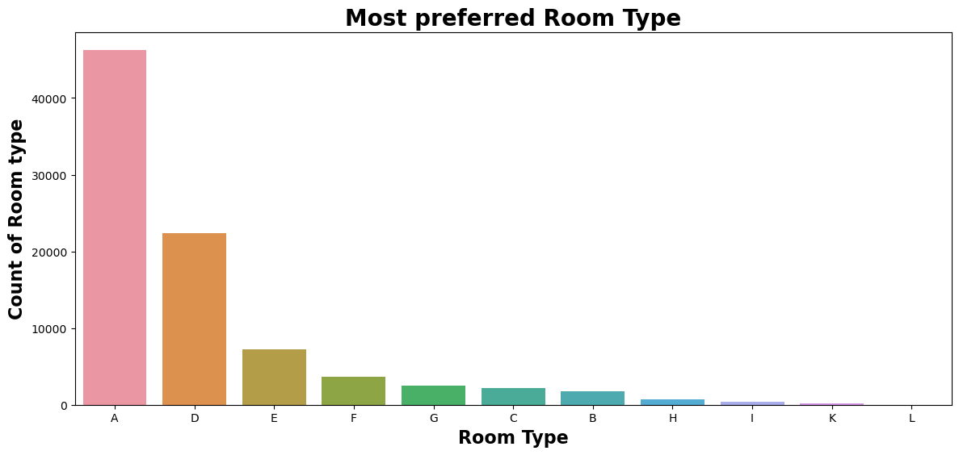
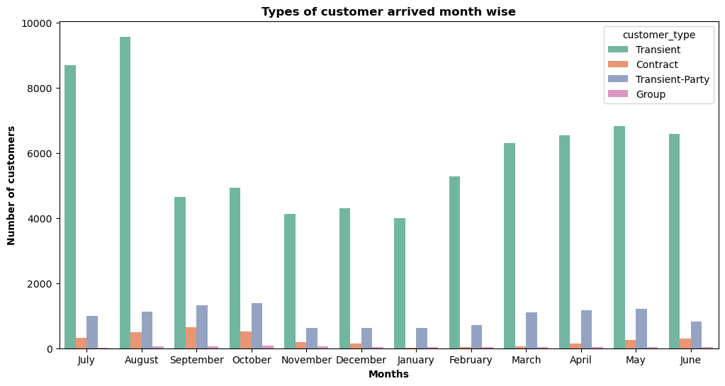
It is found that the most preferred Room type is 'A'. So, majority of the guests have shown interest in this room type. So, overall this chart shows room type 'A' is most preferred by guests.
It can be summarised that the Transient type of customers visit the most whereas the visitors who are in group comes in the category of least visitors.

Slide 11
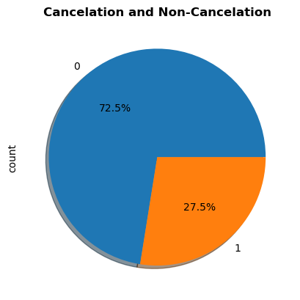
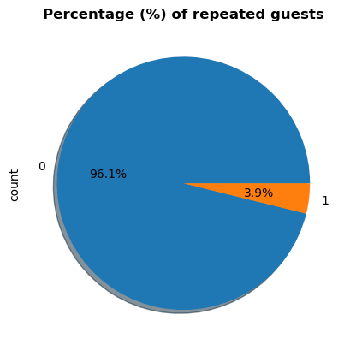
we have found the insights that more than 1/4th of the overall bookings i.e. approx. 27.5% of the tickets was got cancelled.
Repeated guests are very few which is only 3.9% while 96.1% guests are not returning to the same hotel. So, it's a matter of deep thinking and taking proper steps to increase the repeated guests numbers for both type of hotels. In order to retained the guests management should take feedbacks from guests and try to improve the services.

Slide 12
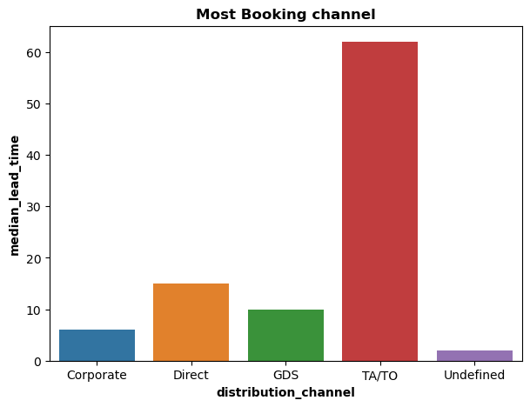
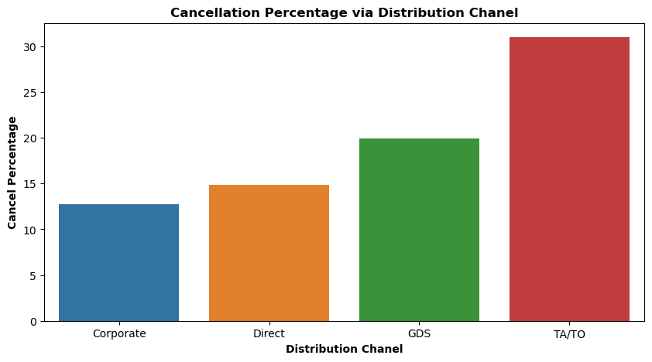
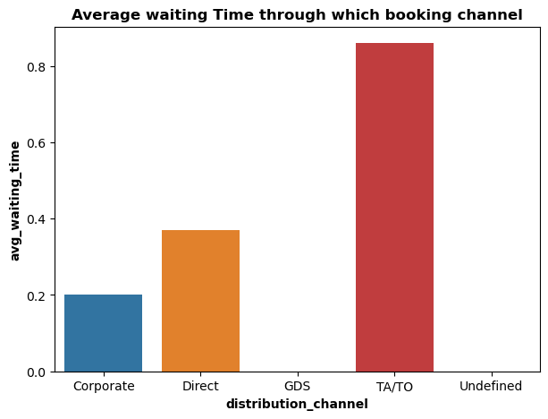
TA/TO has highest booking cancellation %. Therefore, a booking via TA/TO is 30% likely to get cancelled. let us see what causes the cancelation of bookings of rooms by customers.
TA/TO is mostly used for planning Hotel visits ahead of time. But for sudden visits other mediums are most preferred.
While booking via TA/TO one may have to wait a little longer to confirm booking of rooms.

Slide 13
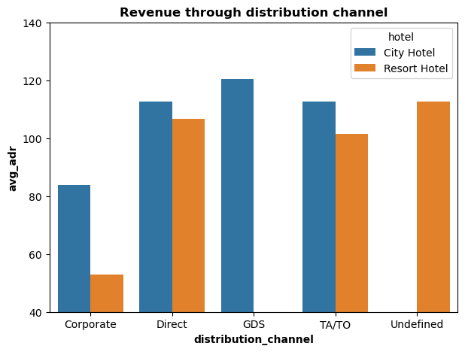
GDS channel brings higher revenue generating deals for City hotel, in contrast to that most bookings come via TA/TO. City Hotel can work to increase outreach on GDS channels to get more higher revenue generating deals.
Resort hotel has more revenue generating deals by direct and TA/TO channel. Resort Hotel need to increase outreach on GDS channel to increase revenue.

Slide 14
TA/TO has highest booking cancellation %. Therefore, a booking via TA/TO is 30% likely to get cancelled.

Slide 15
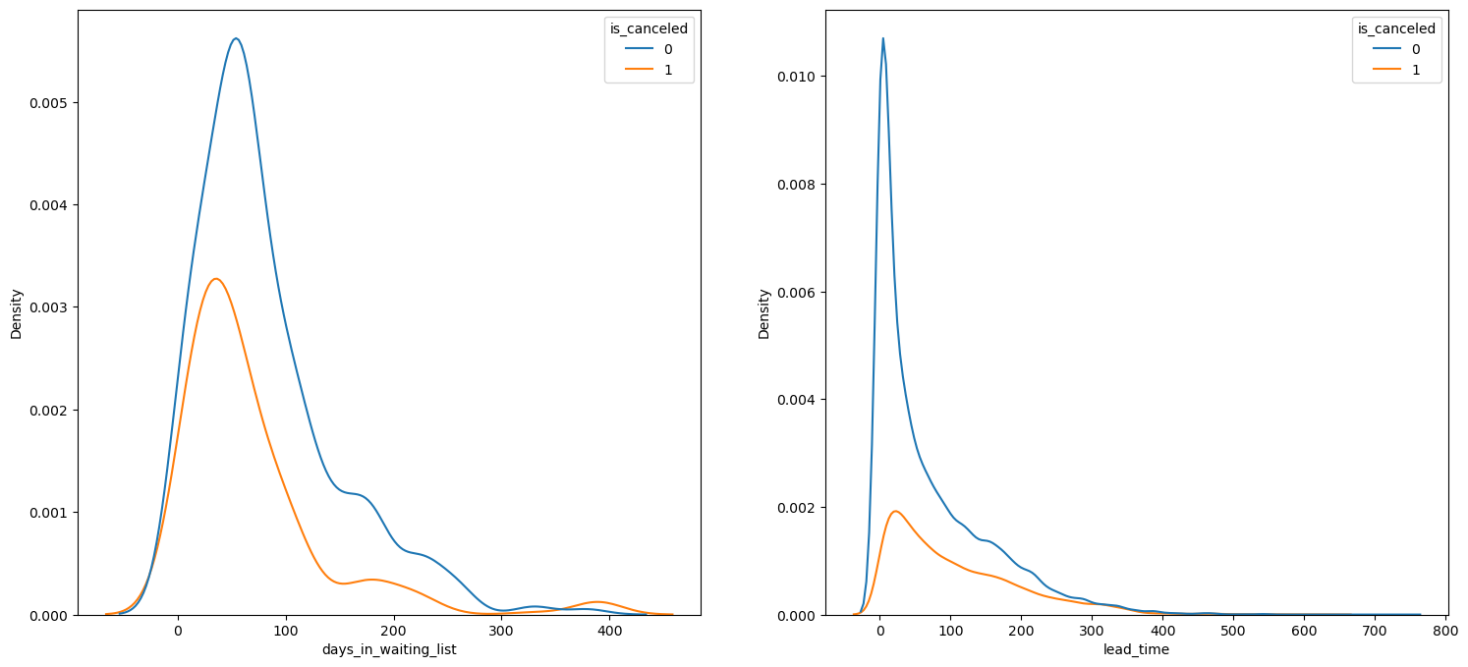
We see that most of the bookings that are cancelled have waiting period of less 150 days but also most of bookings that are not cancelled also have waiting period less than 150 days. Hence this shows that waiting period has no effect on cancellation of bookings.
Also, lead time has no affect on cancellation of bookings, as both curves of cancelation and not cancellation are similar for lead time too.

Slide 16
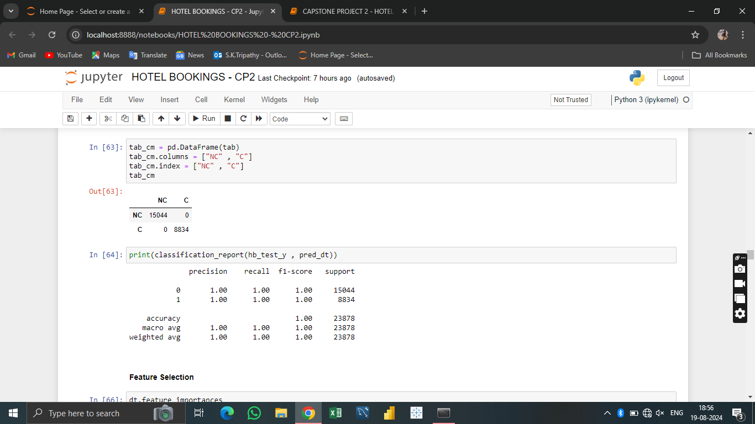
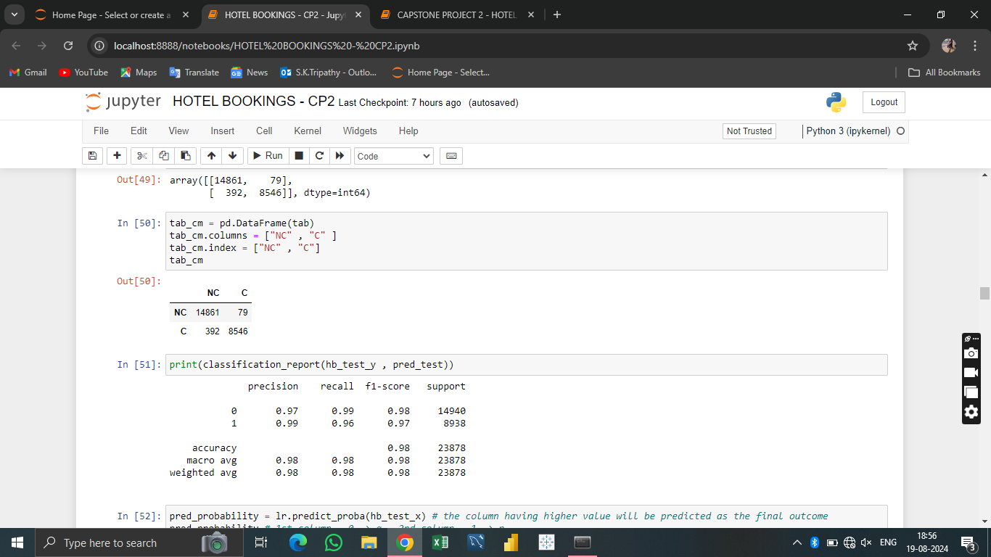
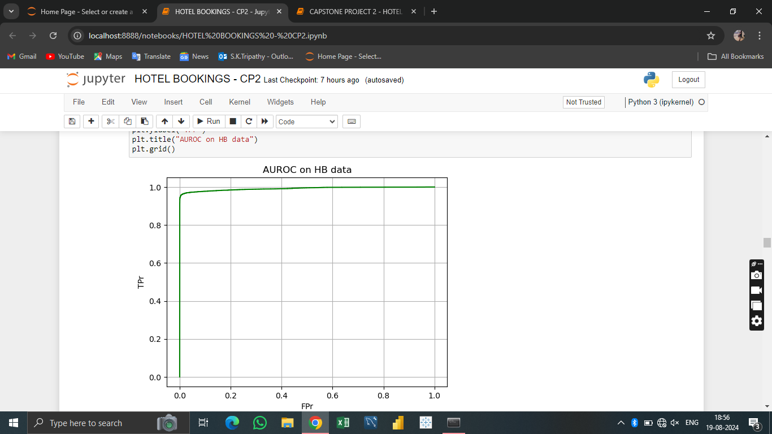
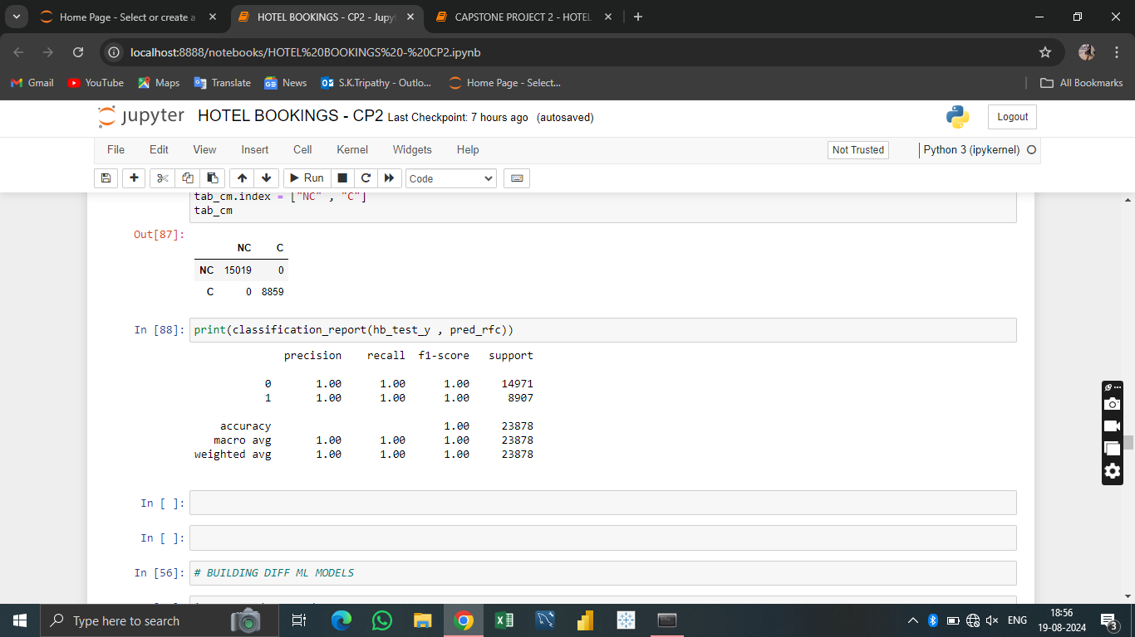
Logistic Regression
Decision Tree
Random Forest

Slide 17
CHALLENGES
Lots of column to work on takes lot of time to identify which column to select to start with.
Lots of NaN values in data set.

Slide 18
CONCLUSION
City hotels are the most preferred hotel type by the guests. So, we can say that City hotels are the busiest hotel in comparison to the resort hotel.
The average ADR of city hotels is higher as compared to the resort hotels. So, it can be said that these City hotels are generating more revenue than the resort hotels.
The total stay of guests is directly proportional to the adr. So, higher the days of stay, the higher will be ADR and revenue as well.
The percentage of repeated guests is very low. Only 3.9% people had revisited the hotels. Rest 96.1% were new guests. So, retention rate is much low.

Slide 19
'Direct' and 'TA/TO' have almost equally contribution in ADR in both type of hotels. While, GDS has highly contributed in ADR in 'City Hotel' type.
Optimal stay length in both the hotel types (City and Resort Hotel) is less than 7 days. Usually people stay for a week. So, after 1 week, the optimal stay length declined drastically.
Most number of bookings have taken place in the month of July and August. July and August are the favourite months of guests to visit different places.
The mostly used distribution channel for booking is 'TA/TO'. 79.1% bookings were made through TA/TO (travel agents/ tour operators).
While calculating ADR across different month, it is found that for Resort hotel, ADR is high in the months of June, July, August as compared to City Hotels.
Almost 1/4th of the total bookings is cancelled. Approx., 27.5% bookings have got cancelled out of all the bookings.
Majority of the guests have shown interest in the room type 'A'. Room type 'A' is the most preferred room type.

Slide 20
SUGGESTIONS
Increasing prices are associated with a higher rate of cancellations. To mitigate reservation cancellations, hotels could refine their pricing strategies by offering reduced rates for specific locations and providing discounts to customers.
The resort hotel experiences a higher ratio of cancellations compared to the city hotels. Therefore, hotels should consider offering competitive room price discounts on weekends and holidays.
During the month of January, hotels can launch marketing campaigns with attractive offers to boost their revenue, especially since cancellations tend to peak during this period.
Enhancing the quality of hotels and their services, particularly in Portugal, can be an effective approach.

Slide 21
THANK YOU

